Slide 2
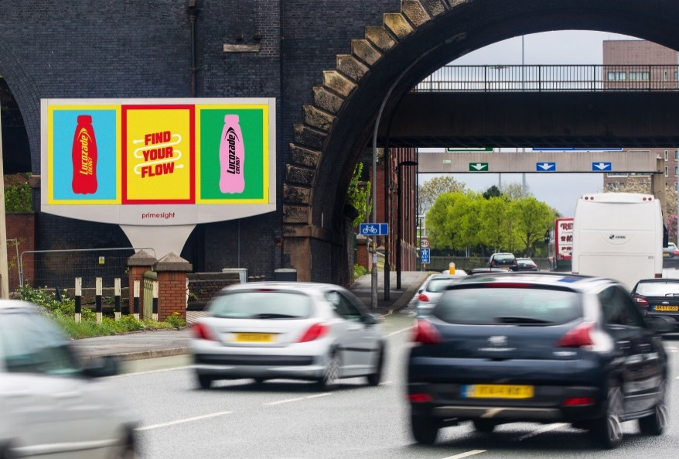
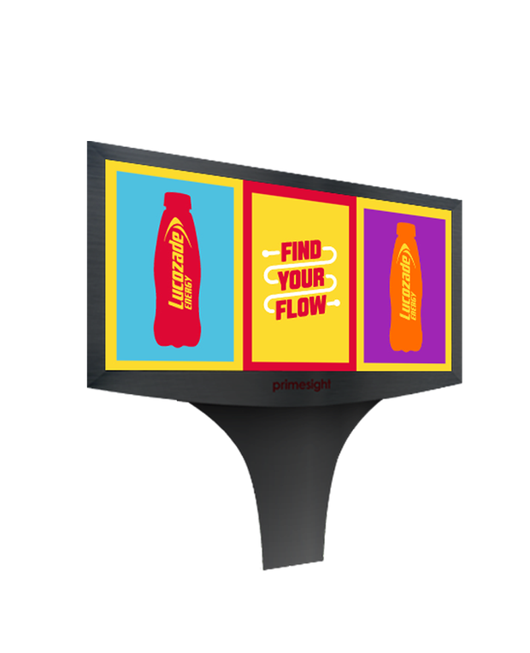
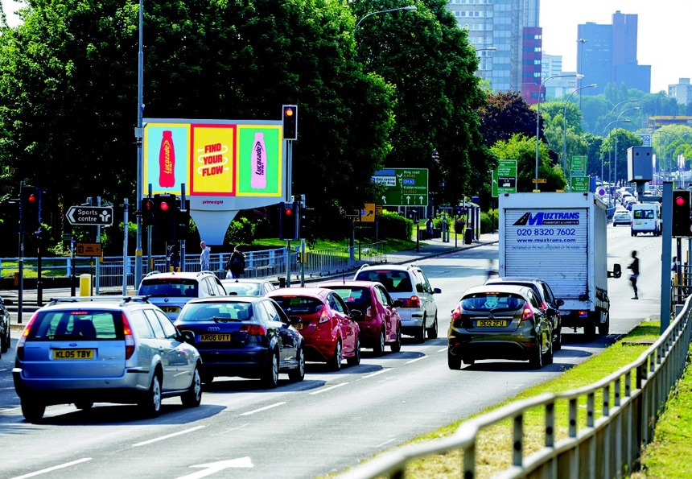
Case study: Lucozade
Lucozade’s ‘Find Your Flow’ was one of the biggest campaigns in 2015, targeting a wide audience of ‘everyday strivers’ with a combination of TV, Radio and OOH. Looking to make a big impact and reposition Lucozade as relevant to everyday dips in energy levels, a further campaign objective was to target a more specific audience of those strivers who are ‘on the move’.
In a media first, and exclusive to Primesight, Lucozade used a combination of digital OOH and radio to create a standout audio-visual experience and amplify their message targeted at everyday strivers on the move. This was achieved by synchronising Lucozade’s radio schedule spot times, which were running adjacent to traffic bulletins on all major radio groups, with Primesight’s portfolio of national digital roadside panels. Once the Lucozade radio ad played during a commuter’s journey, the digital OOH panels seamlessly switched to a full Lucozade domination, creating a multi-sensory, targeted experience for drivers.
Research showed that 79% of the target audience saw and heard the OOH and radio campaign, of which 63% were likely to consider purchasing Lucozade Energy as a result of being exposed to the campaign. This is 37% more likely than those just exposed to radio and 23% more than those just exposed to outdoor. Significantly, 40% of those exposed to both OOH and radio were spontaneously aware of the Lucozade brand.

Slide 3
Outsmart
Third Floor
43 Dorset Street
London W1U 7NA
outsmart.org.uk

